Slide 1

Exception Handling

Slide 2
INDEX
Introduction
Raising an Exception
Exception-Handling overview
Sample program
Python exception Hierarchy
Finally clause
Exception objects and Tracebacks
User defined Exception class
Assert

Slide 3
INTRODUCTION
python provides the runtime errors via exception handling method with the help of try-except.
Even if a statement or expression is syntactically correct, it may cause an error when an attempt is made to execute it. Errors detected during execution are called ”Exceptions”.
Exception handling enables programmers to create applications that can resolve exceptions.
Python creates traceback objects when it encounters exceptions.

Slide 4
RAISING AN EXCEPTION
raise statement indicates an exception occurred
Simplest form of throwing (or raising) an exception is keyword raise, followed by exception name and possibly arguments that initialize the exception object

Slide 5
EXCEPTION-HANDLING OVERVIEW
Exception handling
  improves program clarity and modifiability by removing error-handling code from the “main line” of the program’s execution
  Improves a program’s fault tolerance
Programmers decide which exceptions to handle
Raised (or thrown) exception may be caught (detected) and processed by an exception handler
try statement encloses code that potentially cause exceptions

Slide 6
EXCEPTION-HANDLING OVERVIEW
try statement encloses code that potentially cause exceptions
try statement may specify zero or more except clauses
except clause specifies zero or more exception class names that represent exception type(s) that the clause can handle
Python uses termination model of exception handling in which the try suite that raises an exception expires immediately
# Python program to handle simple runtime error
a = [1, 2, 3]
try:
print "Second element = %d" %(a[1])
# Throws error since there are only 3 elements in array
print "Fourth element = %d" %(a[3])
except IndexError:
print "An error occurred"

Slide 7
EXCEPTION-HANDLING OVERVIEW
The try statement works as follows.
  First, the try clause (the statements between the try and except keywords) is executed.
  If no exception occurs, the except clause is skipped and execution of the try statement is finished.
  If an exception occurs during execution of the try clause, the rest of the clause is skipped. Then if its type matches the exception named after the except keyword, the except clause is executed.
  If an exception occurs which does not match the exception named in the except clause, it is passed on to outer try statements; if no handler is found, it is an unhandled exception and execution stops with a default message.
  The try-except statement has an optional else clause, which, when present, must follow all except clauses. It is useful for code that must be executed if the try clause does not raise an exception.

Slide 8
SAMPLE PROGRAM
1 # Fig. 12.1: fig12_01.py
2 # Simple exception handling example.
3
4 number1 = raw_input( "Enter numerator: " )
5 number2 = raw_input( "Enter denominator: " )
6
7 # attempt to convert and divide values
8 try:
9 number1 = float( number1 )
10 number2 = float( number2 )
11 result = number1 / number2
12
13 # float raises a ValueError exception
14 except ValueError:
15 print "You must enter two numbers"
16
17 # division by zero raises a ZeroDivisionError exception
18 except ZeroDivisionError:
19 print "Attempted to divide by zero"
20
21 # else clause's suite executes if try suite raises no exceptions
22 else:
23 print "%.3f / %.3f = %.3f" % ( number1, number2, result )
Code in try suite may raise exceptions
Division by zero raisesZeroDivisionError exception
Catches ValueError exception raised by float
Executes only if try suite did not raise any exceptions

Slide 9
SAMPLE PROGRAM
Enter numerator: 100
Enter denominator: 7
100.000 / 7.000 = 14.286
Enter numerator: 100
Enter denominator: 0
Attempted to divide by zero

Slide 10
EXCEPTION HIERARCHY
Exceptions inherit from base class Exception
Exceptions defined in module exceptions
Exception names already in built-in namespace
Four primary classes
  SystemExit: terminates program execution when uncaught
  StopIteration: raised when for loop reaches end of its sequence
  Warning: indicates certain elements of Python may change in the future
  StandardError: base class for all Python error exceptions (e.g., ValueError and ZeroDivisionError)

Slide 11
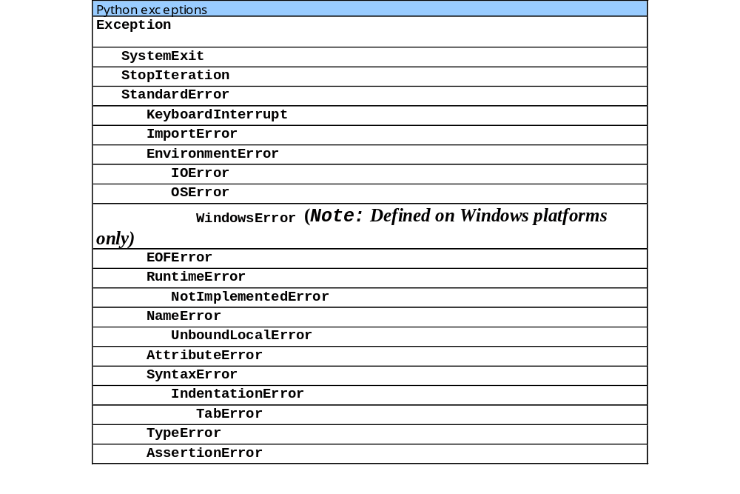
EXCEPTION HIERARCHY

Slide 12
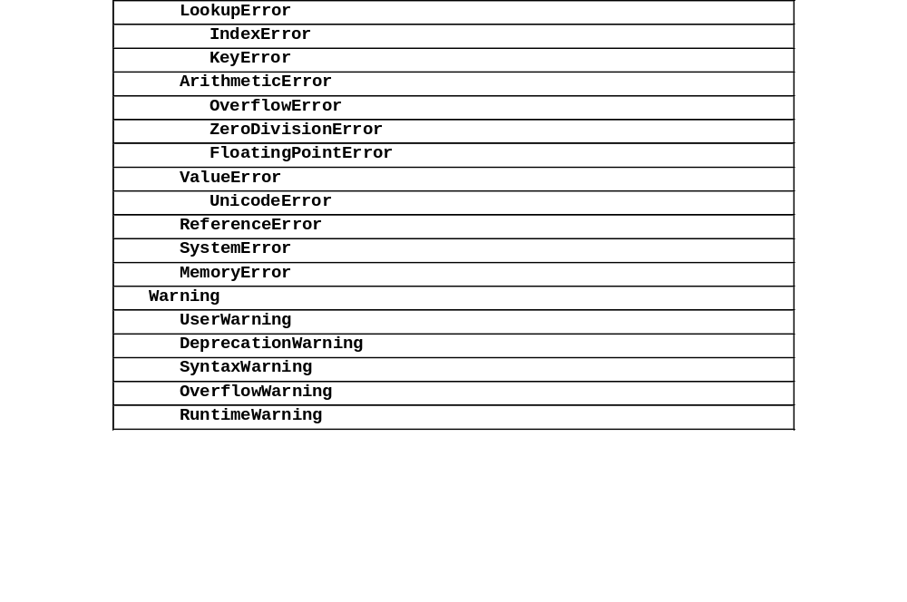
EXCEPTION HIERARCHY

Slide 13
FINALLY CLAUSE
Guaranteed to execute if program control enters the corresponding try suite, regardless of whether it executes successfully or an exception occurs
Ideal location for resource-deallocation code, clean up actions.
1 # Fig. 12.3: fig12_03.py
2 # Using finally clauses.
3
4 def doNotRaiseException():
5
6 # try block does not raise any exceptions
7 try:
8 print "In doNotRaiseException"
9
10 # finally executes because corresponding try executed
11 finally:
12 print "Finally executed in doNotRaiseException"
13
14 print "End of doNotRaiseException"
15
try suite does not raise any exceptions
Executes after corresponding try suite

Slide 14
EXCEPTION OBJECTS AND TRACEBACKS
arguments from a raise statement in the exception object’s args attribute
traceback objects contain information about function call stack from the time the exception occurred
Inserts function name at beginning of function call stack
Stack unwinding: process of searching for an appropriate exception handler

Slide 15
USER-DEFINED EXCEPTIONS
Programs may name their own exceptions by creating a new exception class
Should derive directly or indirectly from class Exception
Programmers may wish to create exception types more specific to the problems that occur in their programs

Slide 16
USER-DEFINED EXCEPTIONS
1 # Fig. 12.5: fig12_05.py
2 # Demonstrating a programmer-defined exception class.
3
4 import math
5
6 class NegativeNumberError( ArithmeticError ):
7 """Attempted improper operation on negative number."""
8 pass
9
10 def squareRoot( number ):
11 """Computes square root of number. Raises NegativeNumberError
12 if number is less than 0."""
13
14 if number < 0:
15 raise NegativeNumberError, \
16 "Square root of negative number not permitted"
17
18 return math.sqrt( number )
19
Programmer-defined exception class
Attempt to perform illegal operation on
negative number

Slide 17
USER-DEFINED EXCEPTIONS
20 while 1:
21
22 # get user-entered number and compute square root
23 try:
24 userValue = float( raw_input( "\nPlease enter a number: " ) )
25 print squareRoot( userValue )
26
27 # float raises ValueError if input is not numerical
28 except ValueError:
29 print "The entered value is not a number"
30
31 # squareRoot raises NegativeNumberError if number is negative
32 except NegativeNumberError, exception:
33 print exception
34 # successful execution: terminate while loop
35 else:
36 break
Print exception before returning control to beginning of while loop

Slide 18
USER-DEFINED EXCEPTIONS
Please enter a number: hello
The entered value is not a number
Please enter a number: -900
Square root of negative number not permitted
Please enter a number: 12.345
3.51354521815

Slide 19
ASSERT
An assertion is a sanity-check, when it encounters an assert statement, Python evaluates the accompanying expression, which is hopefully true. If the expression is false, Python raises an AssertionError exception.
The syntax for assert is:
assert Expression [arguments]

Slide 20
SAMPLE PROGRAM
1 # Fig. 12.5: fig12_06.py
2 # Demonstrating a assert program
3
4 def divide(no1, no2):
assert (no2 != 0), “Can not divide by Zero\n”
return no1 / no2
7
divide(24,2)
divide(4,0)

